Slide 1
Balancing Robot
John Hitti & Nick Llarena

Slide 2
Creating the robot structure
Steps were followed from within yilectronics.com to learn the basics of different components.
The different components were connected to a breadboard to verify functionality.
All components were connected together on a breadboard as a prototype to test before designing a PCB.

Slide 3
Wiring the breadboard/General Schematic

Slide 4
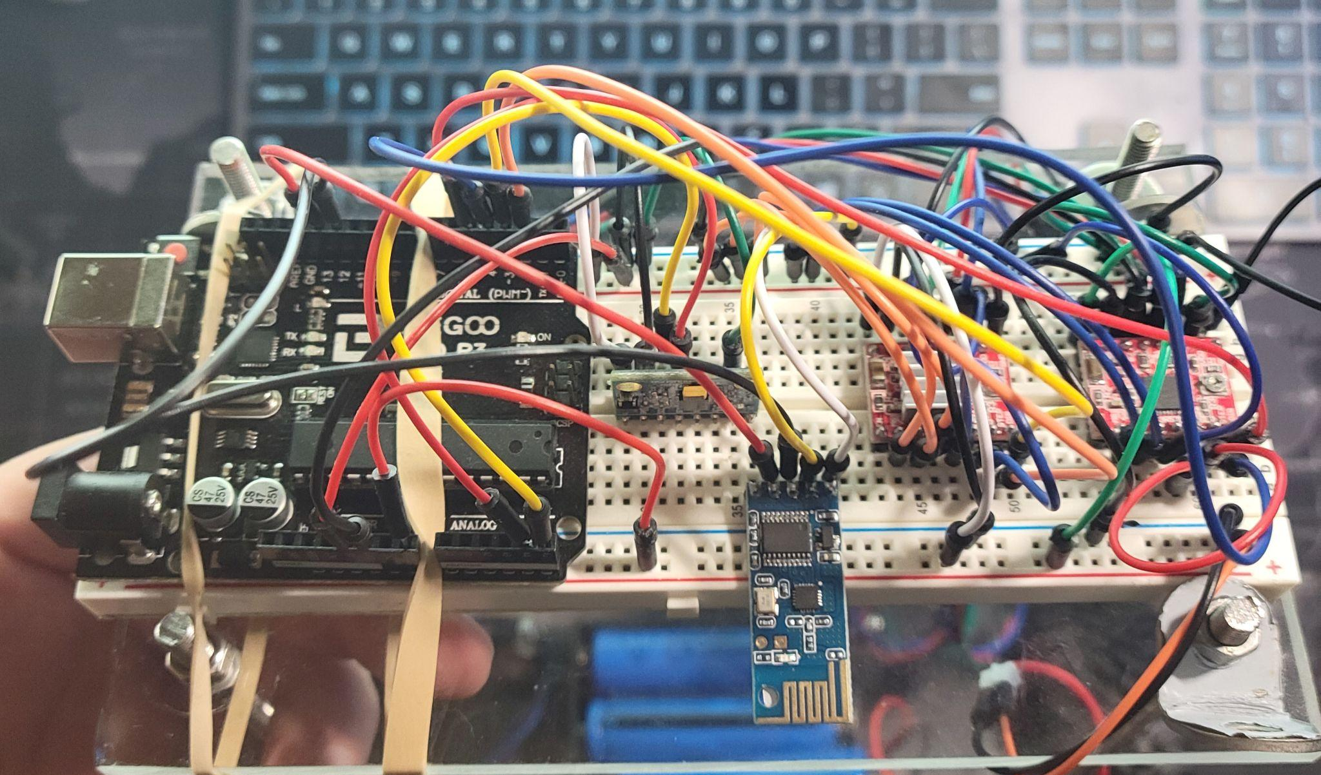
Putting Everything Together

Slide 5
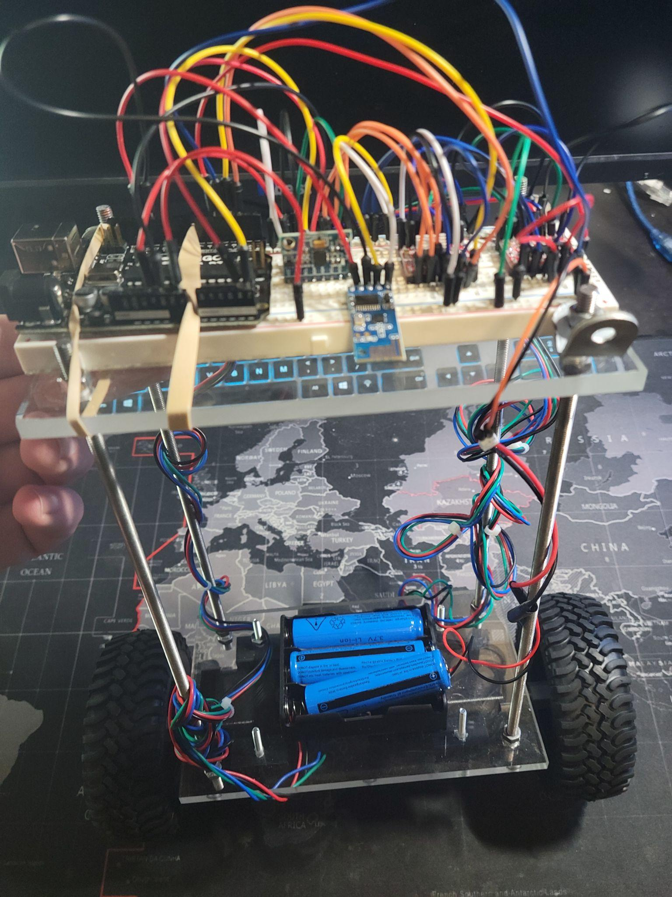
Putting Everything Together

Slide 6
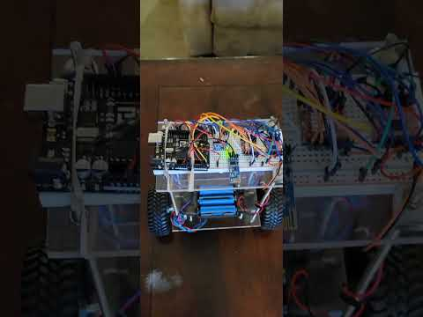

Slide 7
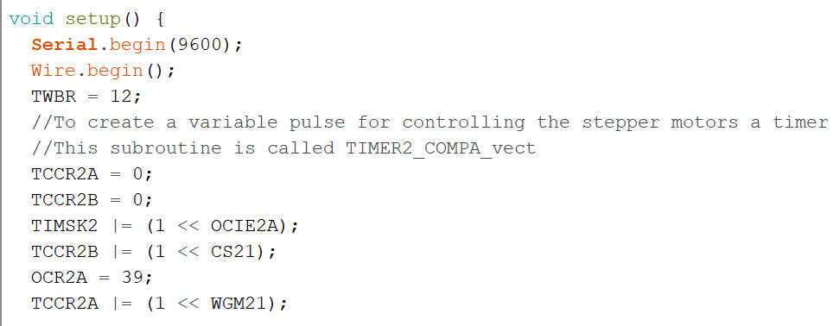
Code: ISR Timer Setup
Set up the ISR timer in the code.
The ISR timer will be called every 20us to adjust the movement of the motor.
This is done so the 1-core arduino board can do two separate tasks at once.

Slide 8
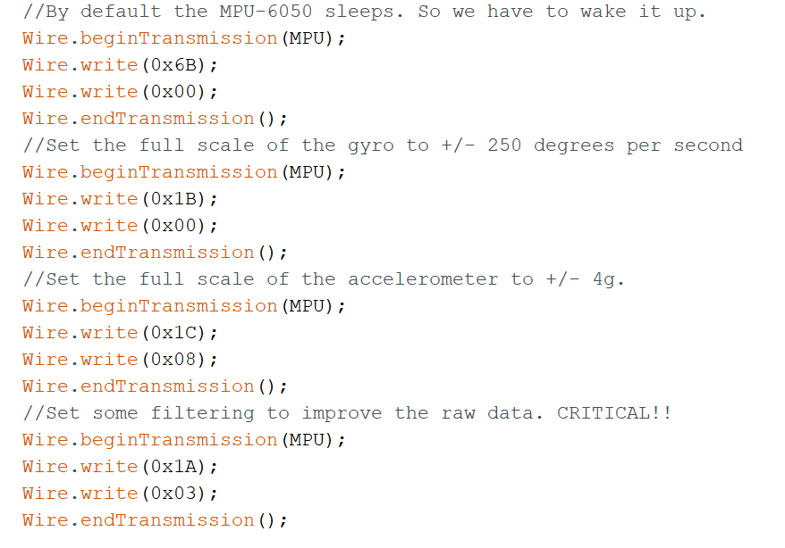
Code: Set up MPU
Wake the MPU chip up and set the scale of the gyroscope and accelerometer accordingly
Add filtering to improve the acquired data.

Slide 9
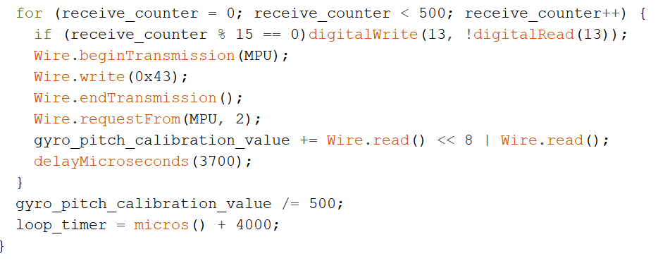
Code: Acquire Starting Position
Get an average angle value from the MPU so we know where “upright” is.
Take the average of 500 measurements.

Slide 10
Code: Read raw data from MPU
Notes:
Comes in the form of two bytes to make one integer

Slide 11
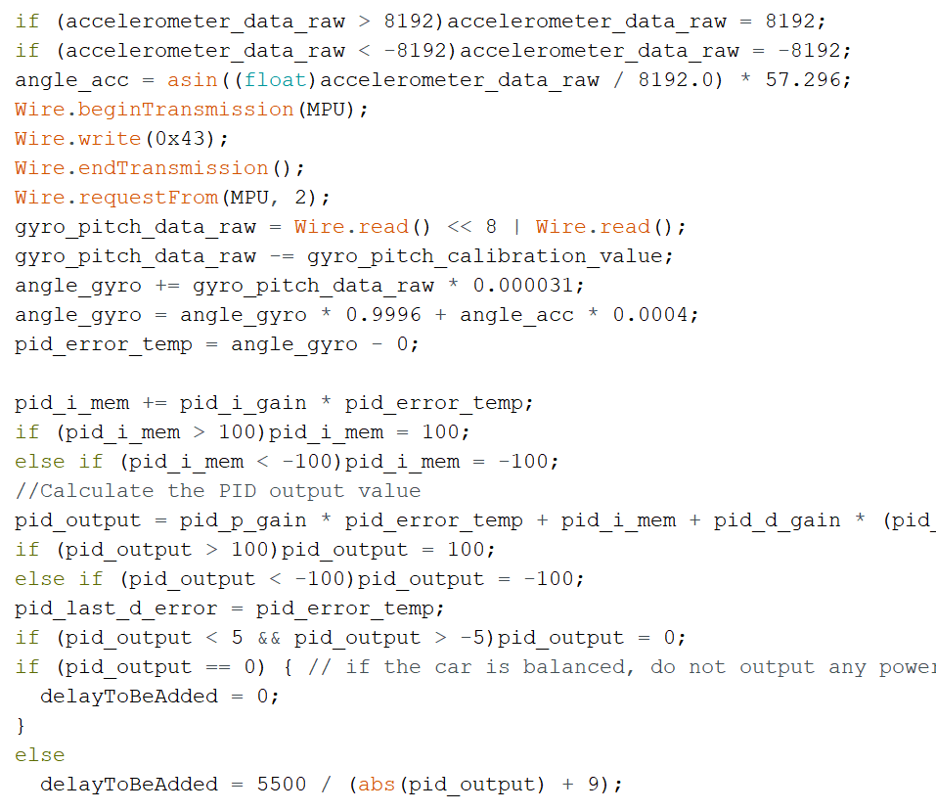
Code: Calculate PID
Limit accelerometer data and calculate angle acceleration
Receive/Calculate our gyroscope data
Calculate the error between the current value and “upright”
Use a PID controller to calculate the appropriate correction value.

Slide 12
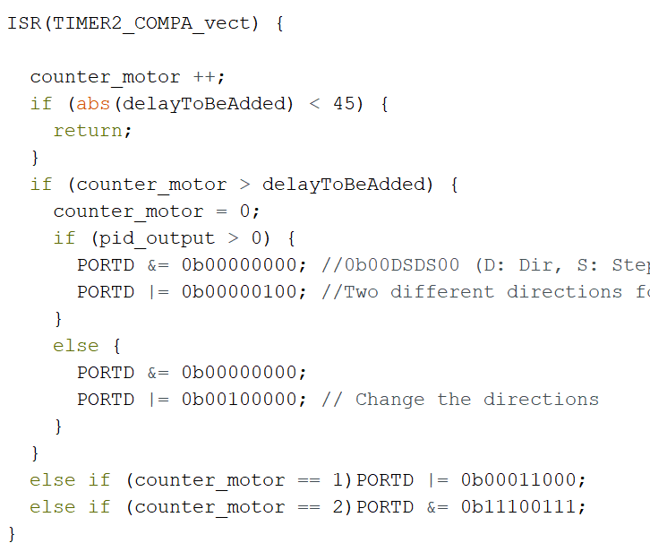
Code: ISR function
Send the appropriate signal to the motors based on the PID output.
Called every 20us

Slide 13
Adding a Circuit Board
Provides stability to the accelerometer reading
Significantly increases durability of the connections between components
Looks less messy more professional

Slide 14
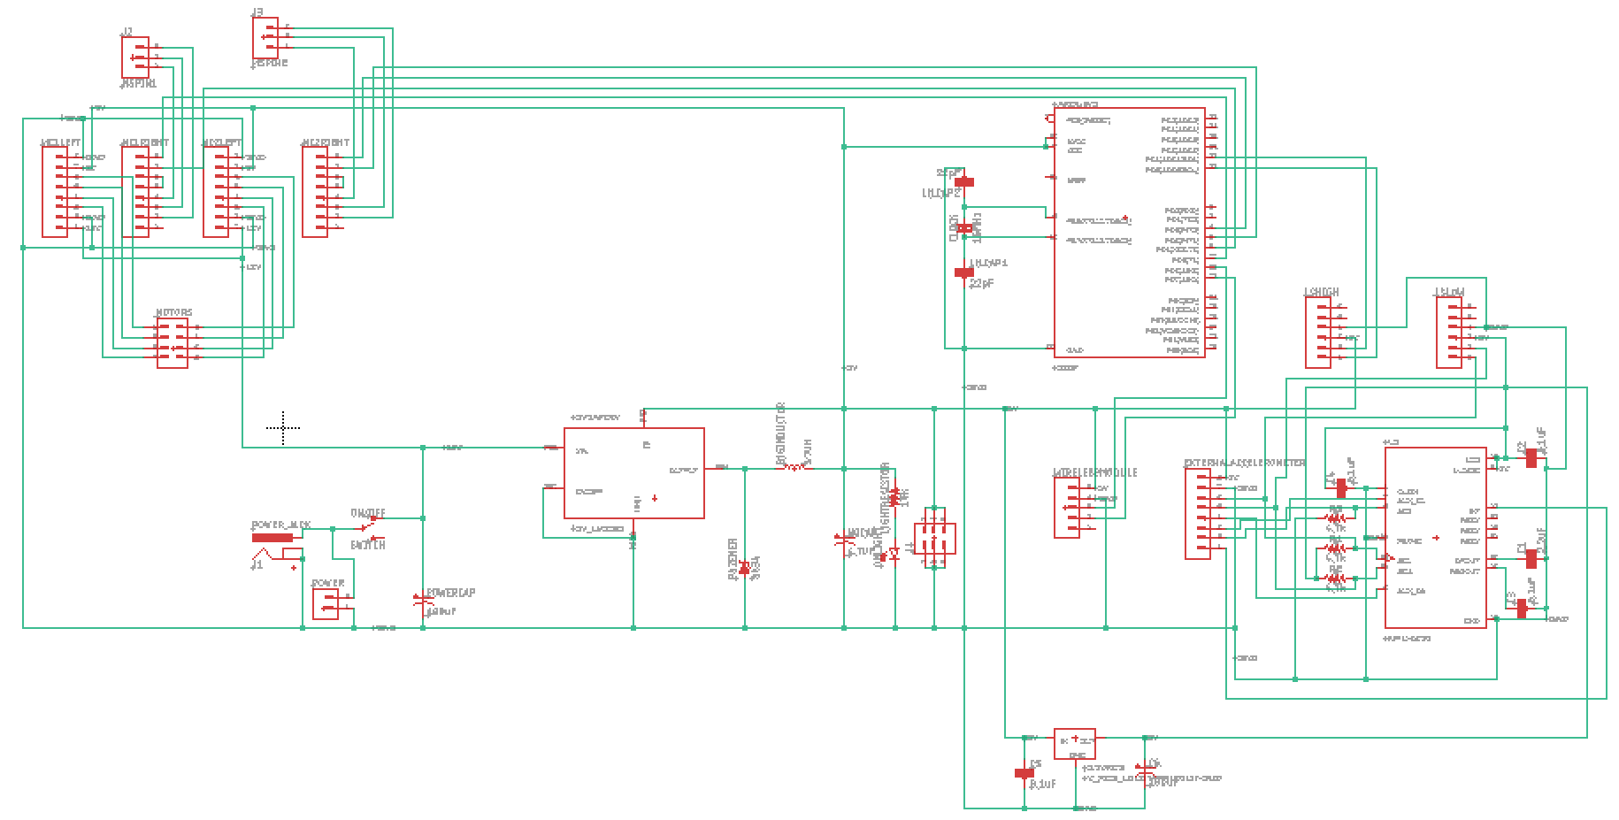

Slide 15
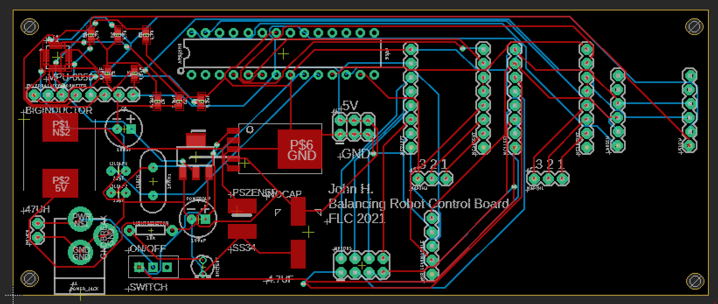

Slide 16
Differences in the Code.
Switch our acceleration out from the Y direction to the Z direction
Account for an error on the PCB. Motor Driver 2’s Direction and Step pins were switched.
Notes:
The pin hughes and lows had to be switched when the port d was set

Slide 17
Testing and Verifying the Circuit Board
Circuit was built and loaded with the same code from the breadboard version (with the modifications).
Non-functioning components (accelerometer) were re-soldered.
An appropriate accelerometer calibration value was entered.
The board works and the robot can respond to changes in angle as expected!

Slide 18
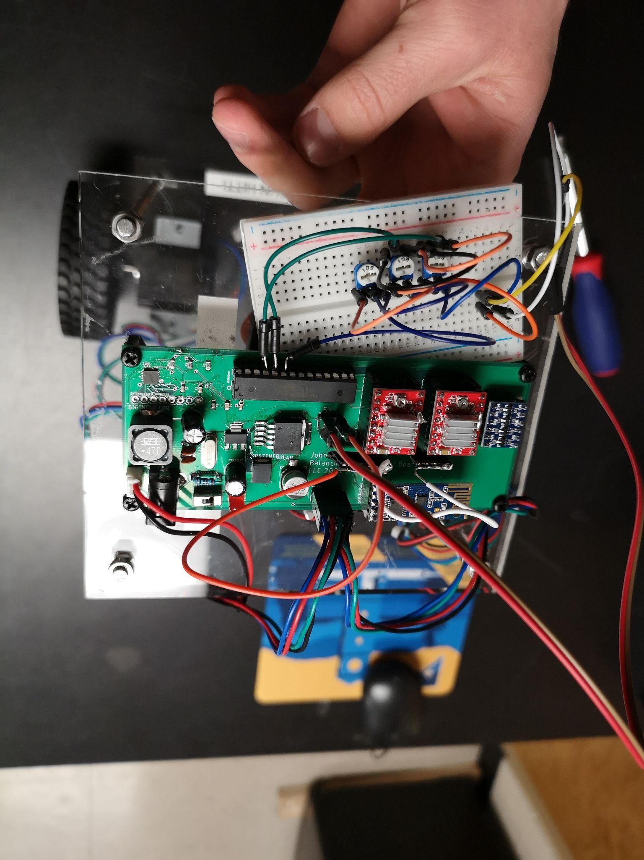
Troubleshooting
No way to effectively communicate with the atmega328p
Chip was removed and connected to the accelerometer to adjust calibration value
We added 3 Potentiometers to control the PID gain values
Loose wheels caused issues
Notes:
Pots were mapped to smaller intervals

Slide 19
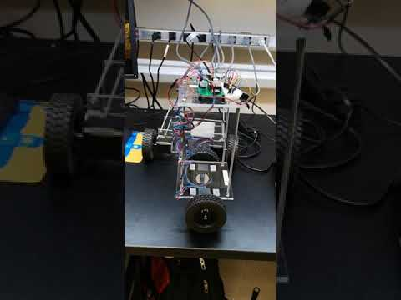

Slide 20
Adding a Joystick
Adds ability to control direction and movement of the robot car.
Designed a PCB to make joystick more professional and user friendly.
More durable and permanent structure than breadboard circuit.

Slide 21
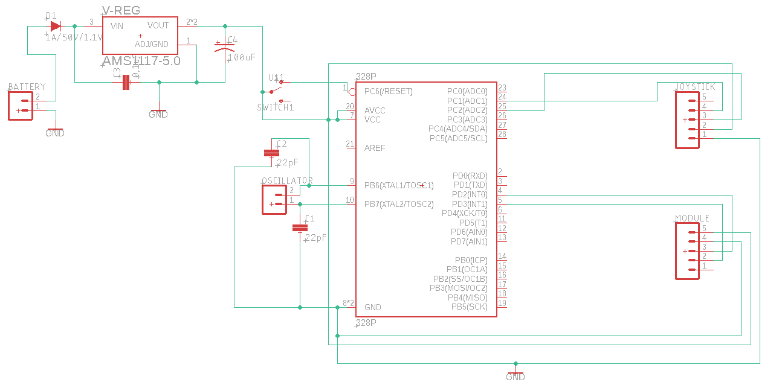

Slide 22
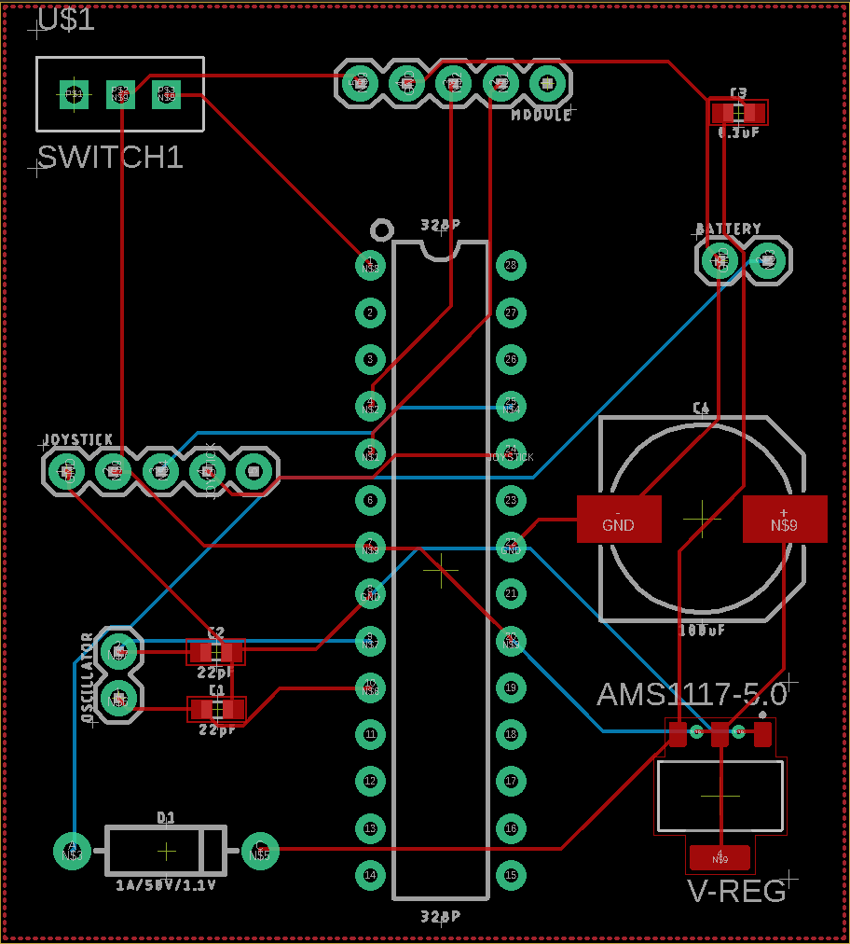

Slide 23
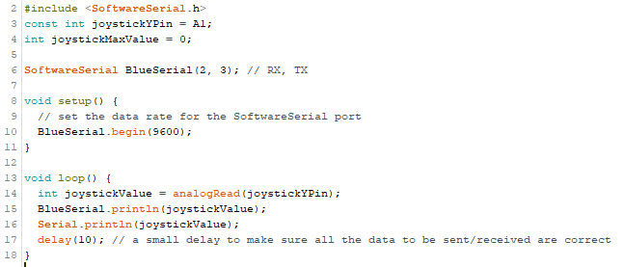
Code for the joystick

Slide 24
Thank you!
Questions?

